Slide 1

Chapter 6
Static Testing
Objectives
Static testing also improves the software quality.
There are bugs which are detectable only through static testing.
There are 3 types of static testing: Inspection, Walkthroughs and Reviews
Inspections are the most widely used technique for static testing which is a formal process to detect the bugs at early stage.
Benefits and effectiveness of inspection process
Variants of Inspection process
Walkthrough is a less formal and less rigorous method as compared to inspection.
Review is higher level technique as compared to inspection or walkthrough, as it also includes management.
© Oxford University Press 2011. All rights reserved.

Slide 2
Static Testing
Static testing techniques do not demonstrate that the software is operational or one function of software is working;
They check the software product at each SDLC stage for conformance with the required specifications or standards. Requirements, design specifications, test plans, source code, user’s manuals, maintenance procedures are some of the items that can be statically tested.
Static testing has proved to be a cost-effective technique of error detection.
Another advantage in static testing is that a bug is found at its exact location whereas a bug found in dynamic testing provides no indication to the exact source code location.
© Oxford University Press 2011. All rights reserved.

Slide 3
Evolution of Software Testing
Static Testing
Types of Static Testing
Software Inspections
Walkthroughs
Technical Reviews
© Oxford University Press 2011. All rights reserved.

Slide 4
Inspections
Inspection process is an in-process manual examination of an item to detect bugs.
Inspection process is carried out by a group of peers. The group of peers first inspects the product at individual level. After this, they discuss potential defects of the product observed in a formal meeting.
It is a very formal process to verify a software product. The documents which can be inspected are SRS, SDD, code and test plan.
© Oxford University Press 2011. All rights reserved.

Slide 5
Inspections
Inspection process involves the interaction of the following elements:
Inspection steps
Roles for participants
Item being inspected
© Oxford University Press 2011. All rights reserved.

Slide 6
Inspections
Inspection Team
Author / Owner / Producer
Inspector
Moderator
Recorder
© Oxford University Press 2011. All rights reserved.

Slide 7
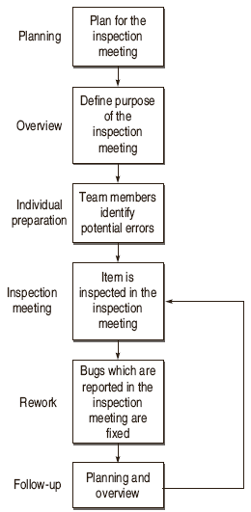
Inspection Process
© Oxford University Press 2011. All rights reserved.

Slide 8
Software Testing Myths
Inspection Process
Benefits of Inspection Process
Bug Reduction
Bug Prevention
Productivity
Real-time Feedback to Software Engineers
Reduction in Development Resource
Quality Improvement
Project Management
Checking Coupling and Cohesion
Learning through Inspection
Process Improvement
© Oxford University Press 2011. All rights reserved.

Slide 9
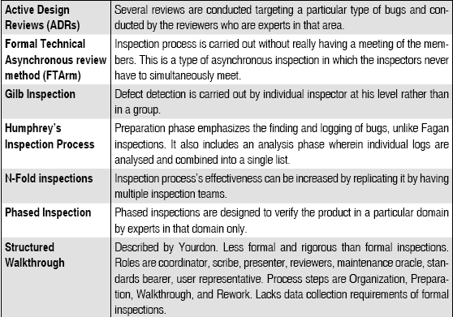
Variants of Inspection process
© Oxford University Press 2011. All rights reserved.

Slide 10

Active Design Reviews
© Oxford University Press 2011. All rights reserved.

Slide 11
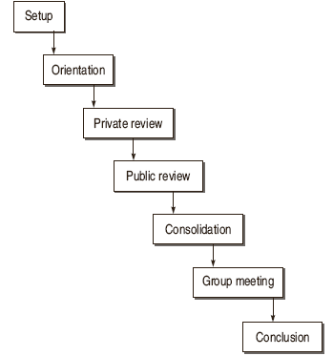
Formal Technical Asynchronous review method (FTArm)
© Oxford University Press 2011. All rights reserved.

Slide 12
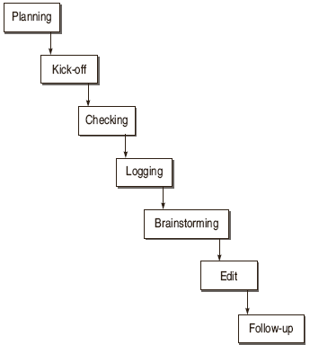
Gilb Inspection
© Oxford University Press 2011. All rights reserved.

Slide 13
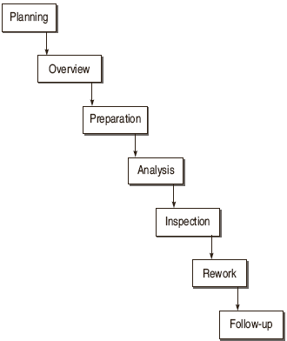
Humphrey’s Inspection Process
© Oxford University Press 2011. All rights reserved.

Slide 14
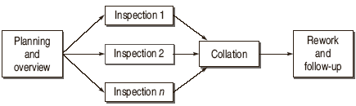
N-Fold Inspection
© Oxford University Press 2011. All rights reserved.

Slide 15
Reading Techniques
A reading technique can be defined as a series of steps or procedures whose purpose is to guide an inspector in acquiring a deep understanding of the inspected software product.
Ad-hoc Method
Checklists
Scenario based Reading
© Oxford University Press 2011. All rights reserved.

Slide 16
Scenario based Reading
Perspective based Reading
software item should be inspected from the perspective of different stakeholders Inspectors of an inspection team have to check software quality as well as the software quality factors of a software artifact from different perspectives.
Usage based Reading
This method given is applied in design inspections. Design documentation is inspected based on use cases, which are documented in requirements specification.
Abstraction driven Reading
This method is designed for code inspections. In this method, an inspector reads a sequence of statements in the code and abstracts the functions these statements compute.
© Oxford University Press 2011. All rights reserved.

Slide 17
Scenario based Reading
Task driven Reading
This method is also for code inspections . In this method, the inspector has to create a data dictionary, a complete description of the logic and a cross-reference between the code and the specifications.
Function-point based Scenarios
The scenarios, designed around function-points are known as the Function Point Scenarios. A Function Point Scenario consists of questions and directs the focus of an inspector to a specific function-point item within the inspected requirements document.
© Oxford University Press 2011. All rights reserved.

Slide 18
Scenario based Reading
Task driven Reading
This method is also for code inspections . In this method, the inspector has to create a data dictionary, a complete description of the logic and a cross-reference between the code and the specifications.
Function-point based Scenarios
The scenarios, designed around function-points are known as the Function Point Scenarios. A Function Point Scenario consists of questions and directs the focus of an inspector to a specific function-point item within the inspected requirements document.
© Oxford University Press 2011. All rights reserved.

Slide 19

Structured Walkthroughs
It is a less formal and less rigorous technique as compared to inspection. The very common term used in the literature for static testing is Inspection but it is for very formal process. If you want to go for a less formal having no bars of organized meeting, then walkthroughs are a good option.
© Oxford University Press 2011. All rights reserved.

Slide 20
Structured Walkthroughs team
Coordinator
Presenter/developer
Recorder
Reviewer
Maintenance
Standrds Bearer
User Represntative
© Oxford University Press 2011. All rights reserved.

Slide 21
Technical Reviews
A review is similar to an inspection or walkthrough, except that the review team also includes management. Therefore, it is considered a higher-level technique than inspection or walkthrough.
A technical review team is generally comprised of management-level representatives of the User and Project Management. Review agendas should focus less on technical issues and more on oversight than an inspection.
© Oxford University Press 2011. All rights reserved.

